Slide 1
AFT Final presentation
- Group 3.2
[Motor Block]
Final Presentation
Date: 29.07.21
By-
Aadithya Ramamurthy (3304090)
Shubham Pawar (3309153)
Eungwang Ryu (3261776)
29.07.2021 |

Slide 2
Index
Project
Abstract
Analyze
Cost
Approximation
Comparison
Business Case
Study
Conclusion
29.07.2021 |

Slide 3
I. Project Abstract
Q. AM vs Conventional?
Comparison
≠
Cost
Business
Q. Cost approximation ?
(AM, Conventional)
Q. Think about
Your business case?
Benefit? Dependency?
€
☎
Analyze
Suggestion
Q. What is our
Product?
Additive
Manufacturing
Q. What is suitable?
Q. Until which investment should be taken into account?
A. Only for the product
29.07.2021 |

Slide 4
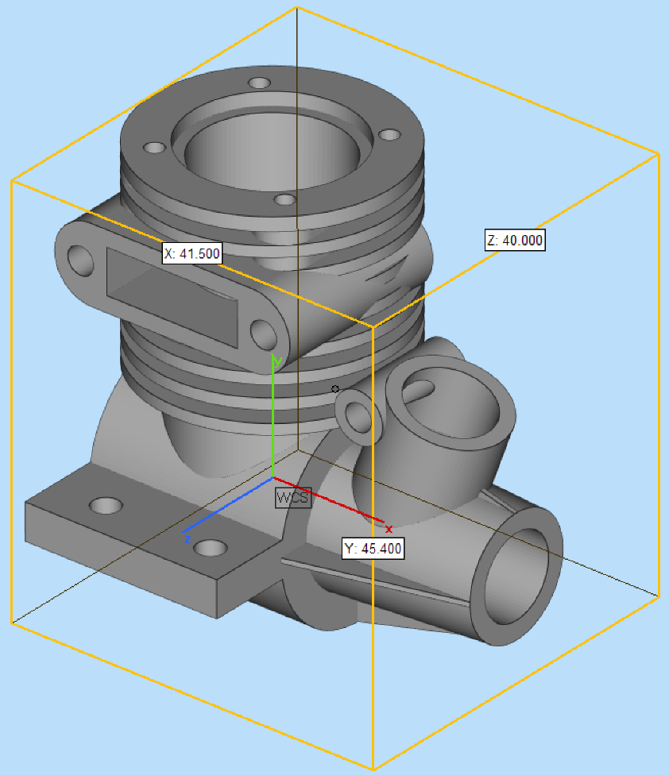
II. Analyze
Part: Motor Block
2. Dimension
  - 1614.92 [Cm^3] (Sides scaled x5)
3. Material
  - Aluminum alloys
Q. Why aluminum?
Creates lighter parts—with more surface finishing options than other die cast alloys.
Aluminum can also withstand the highest operating temperatures of all the die cast alloys.
Cast aluminum is versatile, corrosion resistant; it retains high dimensional stability with thin walls and can be used in almost any industry.
29.07.2021 |

Slide 5
II. Analyze
4. Lot size : huge (under assumption)
Ex: 4 cylinder ICE engine (VW, 2017)
Tiguan: 724,000
Polo: 716,000
Golf: 974,000
Total: 2,414,000 (Vehicles)
-> Total parts: 9,656,000 (parts, Vehicles x4)
Conformity assessment (for AM)
i) Does part fit?
- Yes
ii) Is your part weldable?
- Depend on selection
iii) Can you meet performance requirement?
- Depend on selection
iv) Will your part design print?
- Yes
v) Does your part require post processing?
- Yes
29.07.2021 |

Slide 6
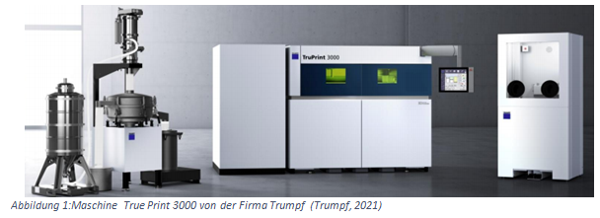
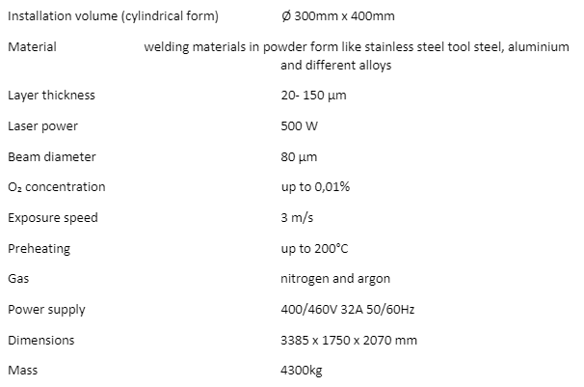
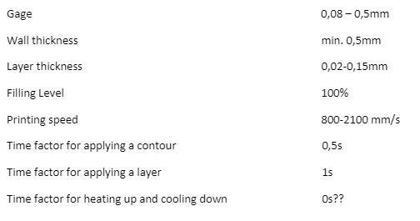
II. Analyze
# 3D Printer
29.07.2021 |

Slide 7
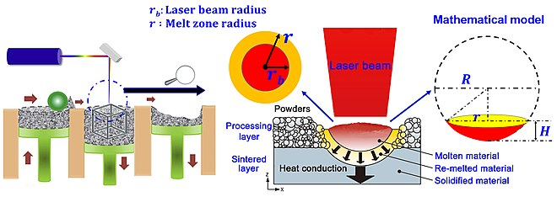
III. Cost Approximation
1. Additive Manufacturing (Selective laser melting)
Design
Design : 0 €
+ Pre-Processing : 0 €
+ Printing : 1146.23 €
- Material Cost: 1116.23
- Building Cost: 30
Post
-processing
Pre
-processing
+ Post-Processing : 80 €
- Machine Op Cost: 60
- Heat treatment: 20
+
Printing
Total Cost : 1226.23 €
* Do not take account the cost for place, factory facility, 3D printer
29.07.2021 |

Slide 8
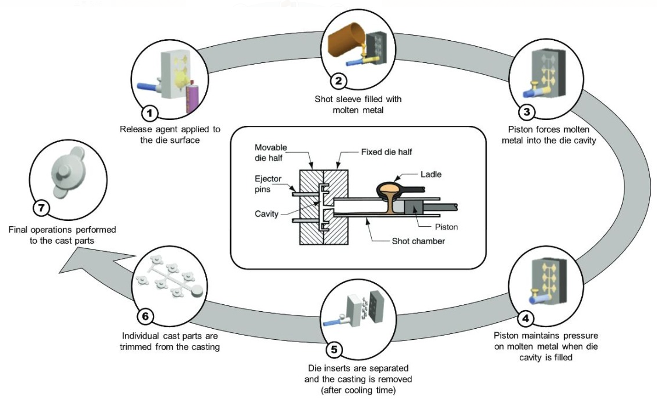
III. Cost Approximation
2. Conventional (HPDC)
Design : 0 € (+ Mold Cost : 22,500 €)
+ Pre-Processing : 0 €
+ Insert : 8.753€
- Material Cost: 8.753 (A380)
+ Inject & Solidification: 14.64€
- Machine Cost (h)
- Labor Cost (h)
- Cycle Time (s)
+ Post-Processing : 53.7€
- Heat treatment Cost
- Machine Op Cost (h)
- Labor Cost (h)
+
Total Cost : 77.09 € (+ 22500 €)
* Do not take account the cost for place, factory facility
29.07.2021 |

Slide 9
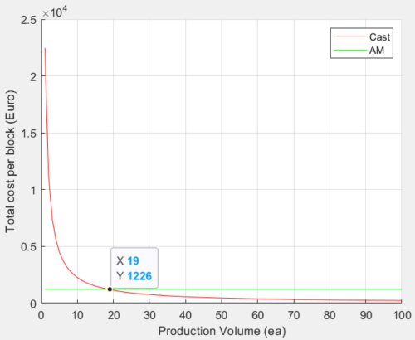
IV. Comparison
Break-Even-Point
Assumption: 3D Printer is always working with project
(even for other project)
29.07.2021 |

Slide 10
IV. Comparison
'A' area (Quantity < 19)
'A'
'B'
- Conventional : Exponentially decreasing price,
Higher price due to initial investment
- AM : Constant price due to the characteristic,
Lower initial investment
'B' area (Quantity > 19)
Break-Even-Point
- Conventional : Lower price after break-even-point,
Price converses to certain level
- AM : Constant price due to the characteristic,
Not economical any more
Assumption: 3D Printer is always working with project
(even for other project)
29.07.2021 |

Slide 11
V. Business Case Study
1. Tendency
Pre-Processing
Insert
Inject
Solidification
Eject
Post-Processing
Design
Cast
0 €
(+22,500 €)
0 €
8.753€
14.64€
53.7€
AM
Design
Pre-Processing
Printing
Post-Processing
0 €
0 €
1146.23 €
80 €
2. Profitability
- Initial Investment: Cast > AM = proper for massive production
- Cost per part: AM < Cast = proper for small lot size production
29.07.2021 |

Slide 12
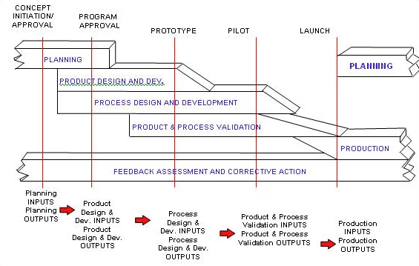
VI. Conclusion
Q. What components or products might be most suitable for AM based on what you have calculated and found?
A1. Small volume parts for prototyping or design check (e.g. PROTO - APQP)
APQP work flow
 | Proto | P1 | P2
Tool | No system tool | System tool | System tool
Worker | No specific worker | - | Line worker
Item | Hand made, modified | Mold | Mold
Lot size | <100 | >100 | -
29.07.2021 |

Slide 13
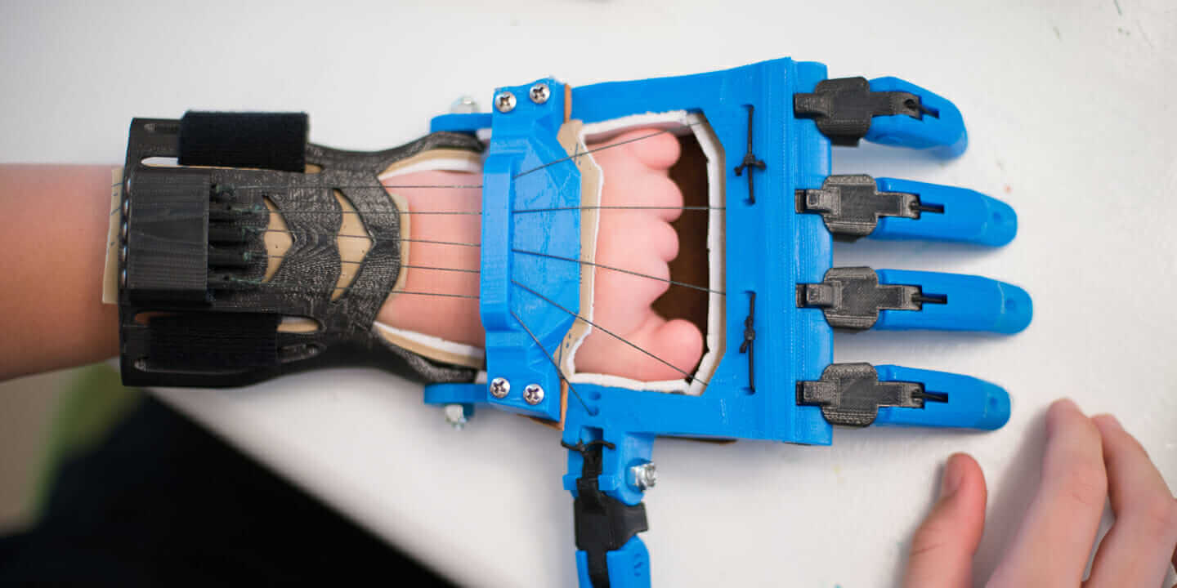
VI. Conclusion
Q. What components or products might be most suitable for AM based on what you have calculated and found?
A2. Personalized or specific application with small volume (e.g. 3d printed prosthetics)
Personalized
Small volume
specific
29.07.2021 |

Slide 14
THANK YOU!
Questions?
29.07.2021 |

